Slide 1


DEPARTMENT OF PHYSICS AND NANOTECHNOLOGY
SRM INSTITUTE OF SCIENCE AND TECHNOLOGY
18PYB103J –Semiconductor Physics
Module 2 Lecture 16
Solving Problems
18PYB103J Module 2 Lecture 16

Slide 2
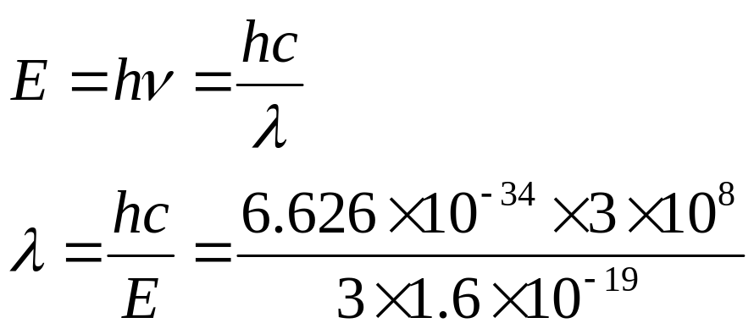
1. Determine the wavelength of radiation given out by an LED with an energy of 3 eV, given that h = 6.626 × 10⁻³⁴ m² kg / s and C= 3 × 10⁸ m/s
We know that
= 414 x 10⁻⁹ m or 414 nm
18PYB103J Module 2 Lecture 16

Slide 3
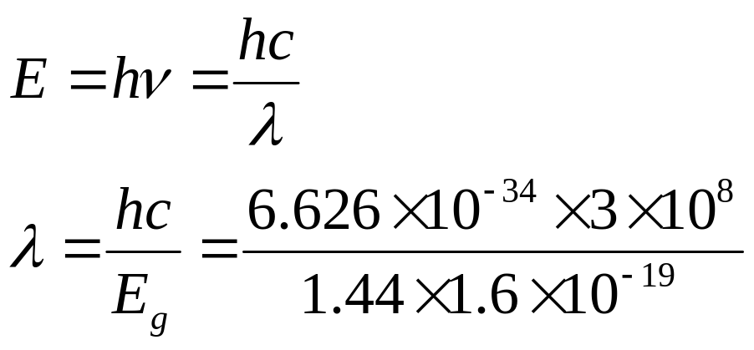
2. Calculate the wavelength of light emission from GaAs whose band gap is 1.44 eV.
We know that
= 8628 x 10⁻¹⁰ m or 8628 Å
18PYB103J Module 2 Lecture 16

Slide 4
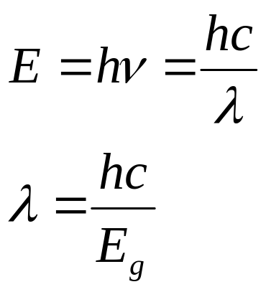
3. Calculate the long wavelength limit of an extrinsic semiconductor if the ionization energy is 0.02 eV.
We know that
= 6.2119 x 10⁻⁵ m
18PYB103J Module 2 Lecture 16

Slide 5
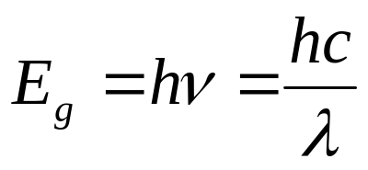
4. An LED has a peak emission wavelength of 1.55 x 10⁻⁶ m. Find its band gap in eV.
We know that
18PYB103J Module 2 Lecture 16

Slide 6
5. A cadmium Sulphide (E_{g}=2.4 eV) photo detector is illuminated with light of wavelength 3000 Å. Find the total energy falling on it and comment whether electron-hole pairs are generated or not?
We know that, total energy falling on it
18PYB103J Module 2 Lecture 16

